Slide 1

Day 1 – Buffer Overflow Introduction
Presentation by the SFSU CyberSec Team

Slide 2

Welcome
Today is going to be interesting because the cyber team will make a great attempt at teaching many concepts all at once.
Follow us on Instagram & join our discord
Please download today’s github workshop repo!
Discord
https://download-directory.github.io/
https://github.com/SFSU-Cyber-Security-Club/Workshops/tree/main/Day1

Slide 3

Thanks for joining!
This can be considered our first meet of the semester. We’re so glad you decided to join us today.
Try your best. Most of the material takes time to digest if it's your first time exposed to it.

Slide 4

The topics to understand BOF (Buffer OverFlow)
Linux operating system
C Library
Python
Assembly x86 ← Important!
File descriptors
Memory Layout
Fundamental understanding of computing
Command line
How C code gets compiled to CPU instructions (general idea)
Structure of x86 Assembly
An exhausted list! Where do we even start? How do we start? What is all of thisssssss.

Slide 5

What is a buffer overflow?
Improper implementation of reading input from the user
Writing past the buffer limit of the program without any checks
Especially hazardous in C
Here’s some C code that contains a “buffer”
#include <stdio.h>
int main()
{
char buffer[20];
}
Here’s an abstract view of what it looks like in your computer’s memory
Buffer
Buffer[0]
Buffer[1]
Buffer[2]
Buffer[3]
Buffer[4]
Buffer[5]...

Slide 6

We won’t be able to cover everything today!
In order to truly understand how a buffer overflow can be used to take advantage of a system, we are going to break down this lecture into multiple sessions

Slide 7
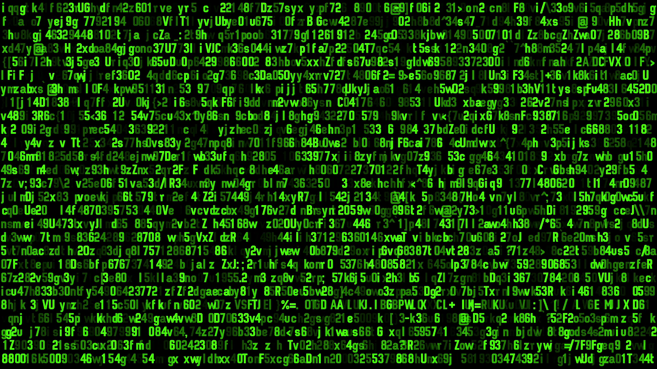



Day 1 – Buffer Overflow Introduction
Chapter 1 - Learning Assembly !!!
“… there's way too much information to decode the Matrix. You get used to it,
though. Your brain does the translating. I don't even see the code. All I see is
blonde, brunette, redhead.” -Cypher, The Matrix

Slide 8

Quick recap - Linux Terminal Commands
==cat [file]
Print the file contents on your terminal
==less [file]
Like cat, but paged, good for long documents
==mv [file1] [file2]
Move file1 to file2, removing file1 and overwriting file2 if it exists
==cp [file1] [file2]
Copy file1 to file2, overwriting file2 if it exists
==rm [file]
Deletes file ==nano / vim / emacs
Command line text editors
==ls
List directory contents
==cd [path]
change directory “..” = previous
==pwd
Print working directory
==man [command] ⇐ MOST IMPORTANT
Manual for command
==apropos [whatever]
Get info on commands/man pages that might do whatever
==echo [text]
Prints whatever to the terminal stdout

Slide 9
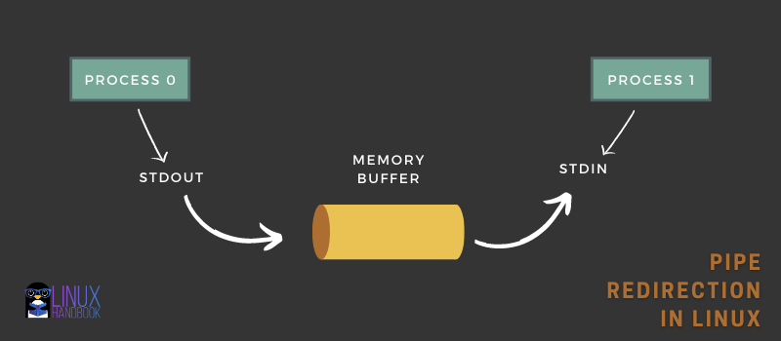
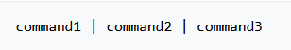
Linux Command Line - Pipe Redirection
The most important concept to learn for the command line!!
Being able to redirect an output to input for another program!
A simple echo, which then has its stdout redirect to “wc” a command that simply outputs the number of characters there are in a given input.

Slide 10
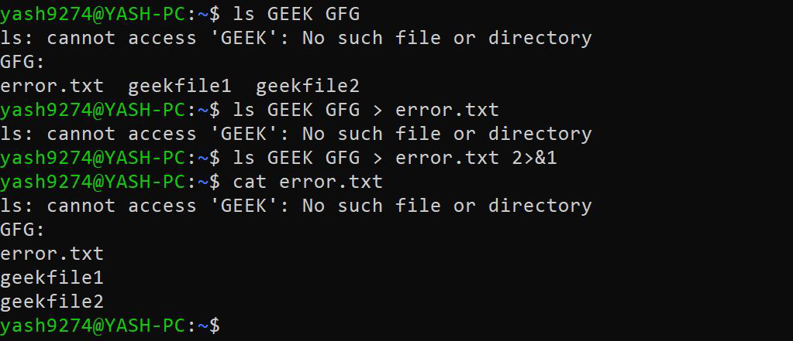
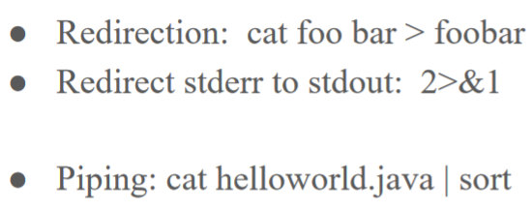
Linux Command Line - Buffer Redirection Cont.

Slide 11
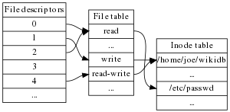
File Descriptors.. AGAIN !
The simplest way to understand file descriptors is by understanding Unix.
(Aka your current Linux operating system backbone)
Everything is treated as a file
When a process is started, it generates a table of numbers denoting different files that it has control over
The most important part! —->
Input/Output (IO) can be / is treated as a file, thus being mapped to the table. MOST IMPORTANT
0 - standard input
1 - standard output
2 - standard error
A process usually has these three opened. unless it doesn’t need them - (daemon)

Slide 12
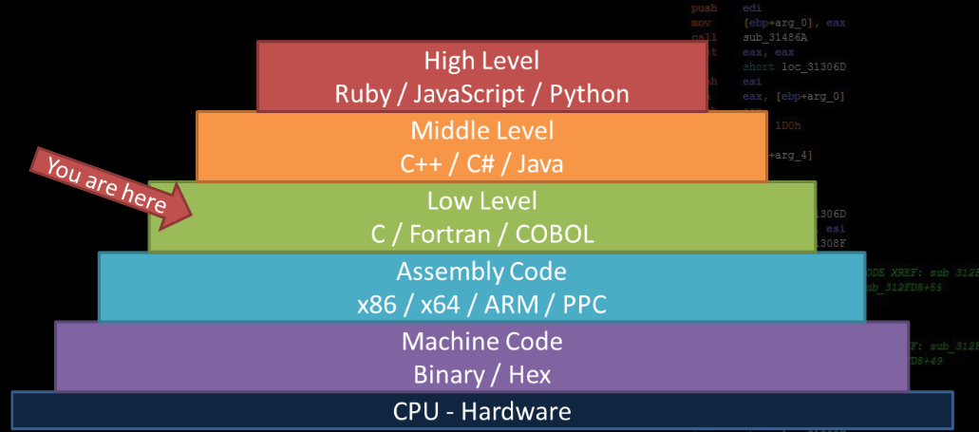
Computer Languages and the Levels of Abstraction - Hello Assembly
Or HERE!
Or here

Slide 13

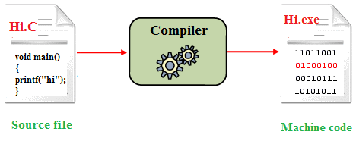
How do statically typed programming languages work?
vs how do dynamically typed.
You write human readable code (that has abstracted the dirty mess that is machine code), and take it through what is known as a “compiler” to convert it to machine readable code (assembly) that can be executed separately from the creation process
In a dynamic programming language, the code that you write is taken through an “interpreter” that translates and executes the code during runtime.
There are programming languages that rest between these two types

Slide 14
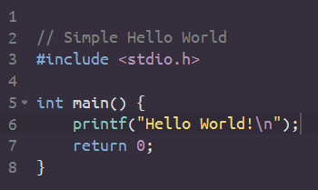
Simple hello world in C
Makes use of external “code” to let us use these common functions. A “Standard”, you may say.
Library to use printf
Main driver function
Everything starts here
Function to print to screen
Good practice, not necessary
user@terminal$: gcc helloworld.c -o helloworld
user@terminal$: ./helloworld
Hello World!
user@terminal$:
Compiling!
Execution!

Slide 15


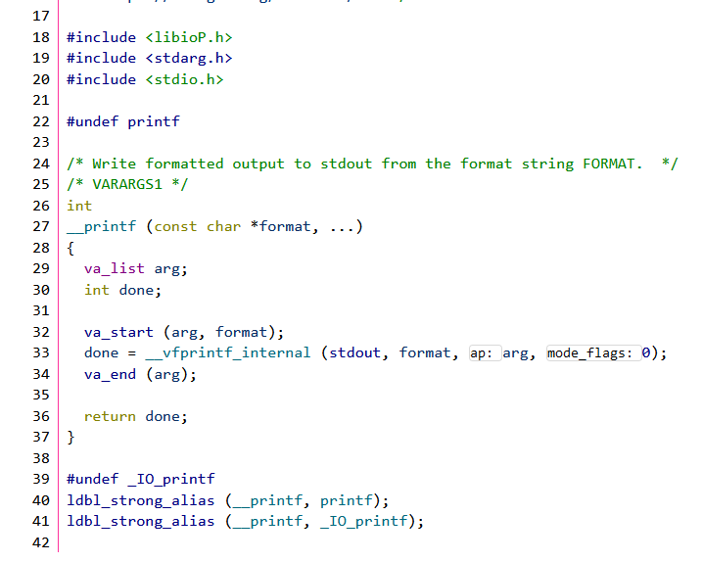
What if I were to tell you…
There are more abstractions…. (cont)
The printf function that we used to print helloworld was code written by pros to abstract the complexities of actually writing helloworld to the terminal
Layers upon layers upon layers of abstraction later…

Slide 16

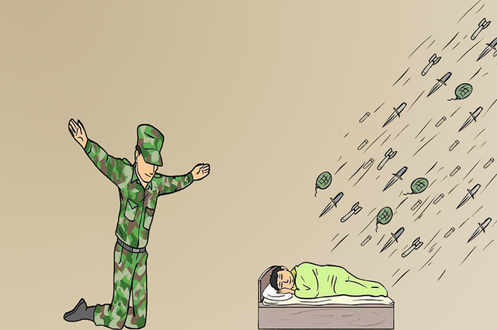

System Calls!
me
Write
Read
Open
Exit

Slide 17
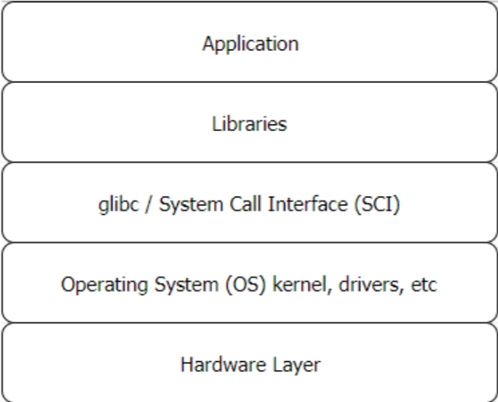
WTF are system calls?
System calls are essentially the only legitimate way of interacting between the user and the operating system.
System calls are part of an “API” to communicate to the “kernel”( which is essentially the operating system’s heart and brain and everything)
Our knowledge of layers come into play here….
Why abstract access to the kernel? Why create system calls?

Slide 18
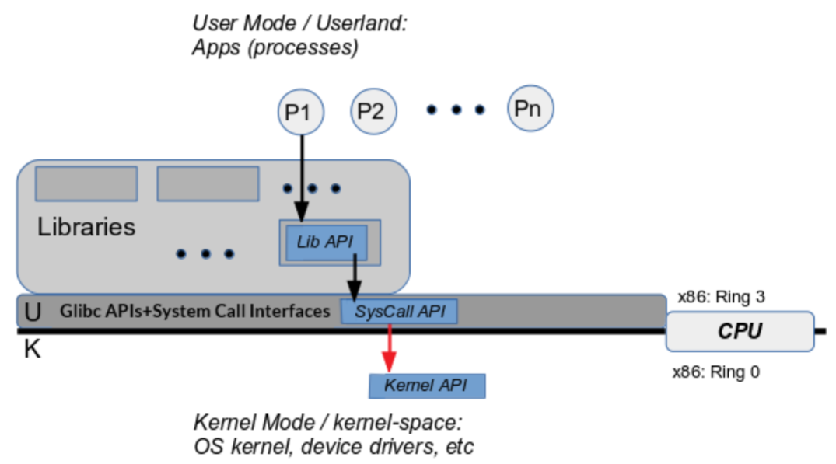

MFW security
A lot of damage could be done if we had direct access to the kernel! We don’t/want to meddle with our brain and hearts right? That’s what those two up there are for, to protect us from ourselves <3

Slide 19
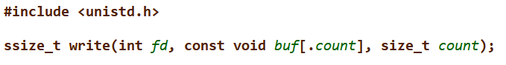

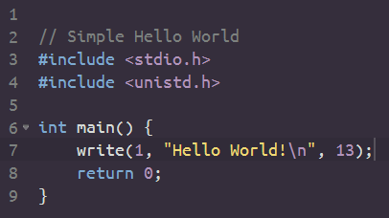
Our look into our first system call..
We looked into printf(“Hello World”), now let’s look at how it really worked….
The write system call!
A system call! - does the same thing! As printf!

Slide 20


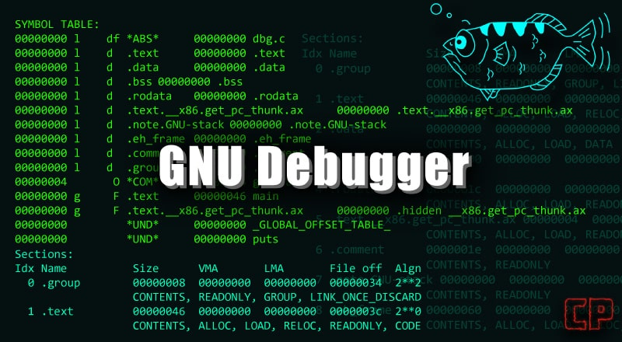
This is it…. We are about to enter the portal of x86 assembly..
Traveller…. It’s too dangerous to travel alone …. Use …….

Slide 21
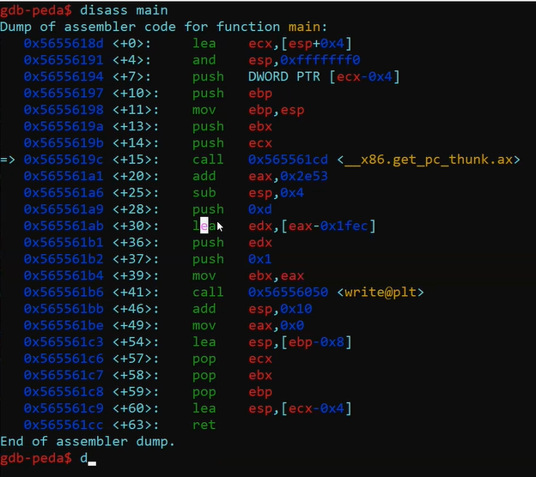
The quick fundamentals of GDB
When we start looking at assembly, we need to use software that will allow us to see the binary and interpret that binary into machine language … assembly
GDB is a command-line based debugger which takes a lot of time to get used to. For the sake of *getting to the point*, we’ll only cover what is necessary to view and run assembly.
We’ll use an extension for gdb to help us!

Slide 22
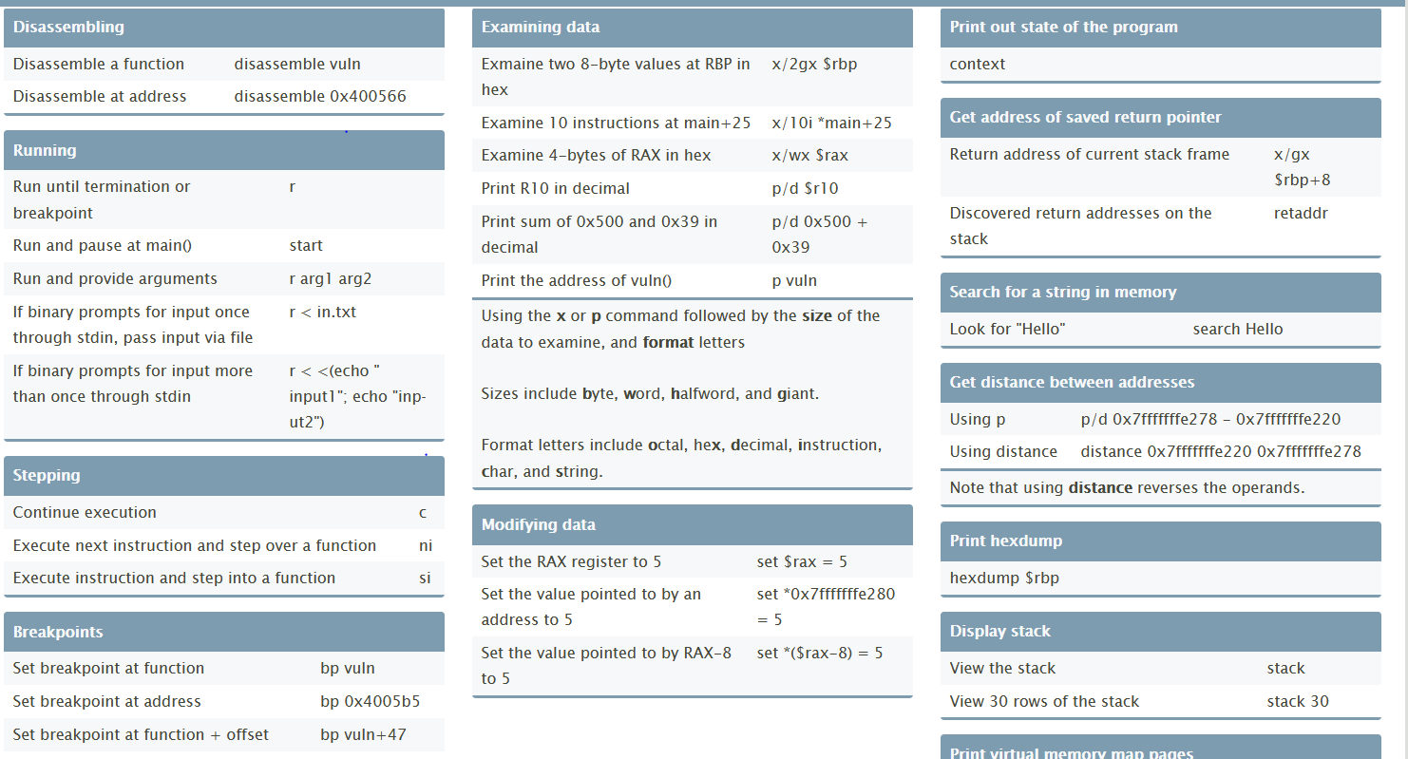
GDB Cheat Sheet — (okay ish quality)
Arrows will be used to denote importance

Slide 23

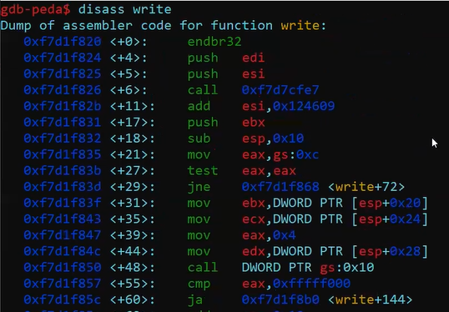
Did you get all of that?
Let’s do a couple of examples in class ..

Slide 24




We’re Ready
To infinity and beyonddd

Slide 25
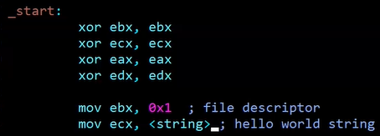
Typical layout for an “instruction” in assembly
This applies to other assembly languages too (ARM, MIPS, …)
instruction (operand1), (operand2)
Sometimes there are more or less operands but this is the format you would see in assembly code.

Slide 26
Instructions could either work with registers, addresses in memory or values.
Works with value & register
Works with register and address(edi+0x6f) translates to an address in memory
Works with a value that represents a location in memory (address)

Slide 27
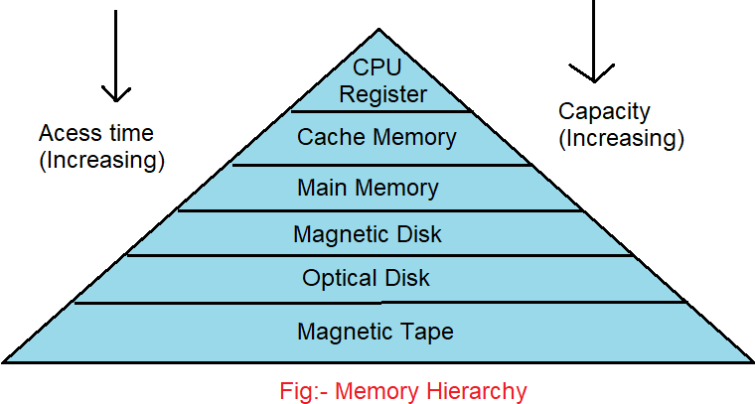
Why have registers? CPU performs the fastest this way..
This allows the CPU
To access memory very quickly, a necessity for a standard machine

Slide 28
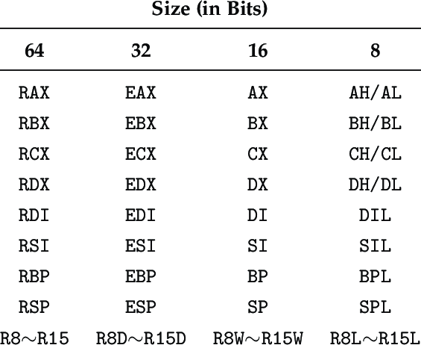

Registers! Take a look at the different ways to address different *sizes of the register*
8 bytes
4 bytes
2 bytes
1 bytes

Slide 29
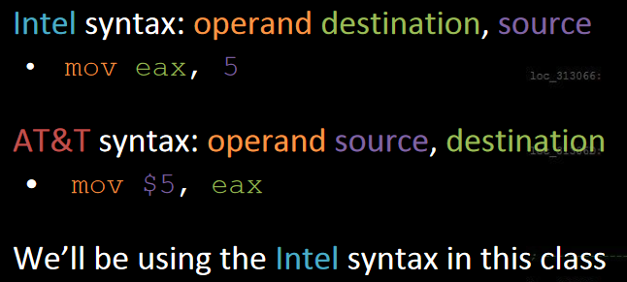
There are two styles of writing x86 assembly…
Stolen from rpisec, excellent material
AT&T syntax is garbage! We’ll use intel for better readability and understanding!

Slide 30
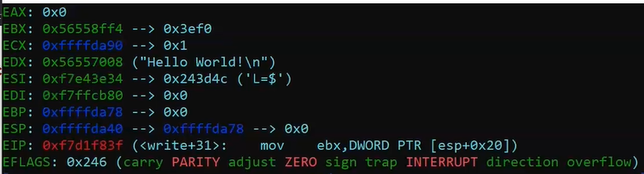
Importance of each register.
RAX, RDX, RBX, RCX
RSP
RBP
RIP
Holds values for general purpose, most instructions are comprised of these 4
Stack pointer - controls a frame of memory that can be useful to address memory relative to it (details covered next class)
Stack frame - Base pointer - somewhat similar to the stack pointer, retains previous stack pointer
Instruction pointer - program counter, points to where the next instruction should be executed.

Slide 31
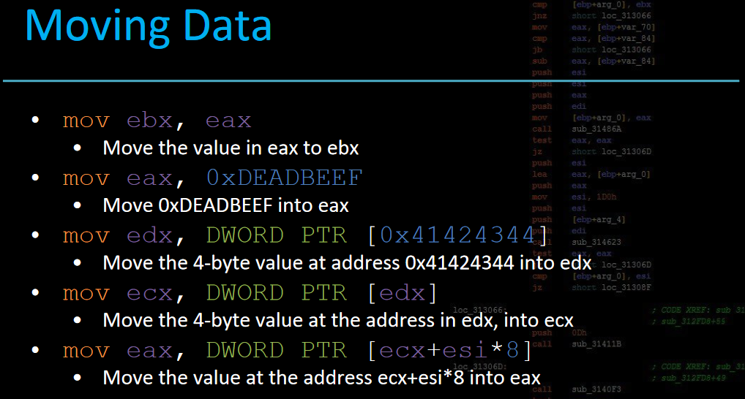
rpisec slides!
The brackets around each [value] or [register] denotes dereferencing the address to get another value (Pointers! Kinda )
0x414124344 → 1234

Slide 32
Moving Data (cont) – the LEA instruction
LEA destination, source
You can treat this somewhat similar to the MOV instruction, however there is a very confusing difference
Normally, when using the [ ] around an address or register holding an address, the mov instruction interprets that as dereferencing the address to obtain whatever was holding it.
When using the [ ] around an address or register holding an address, the lea instruction interprets that dereference as just the address alone, not the value in it. This is useful for performing arithmetic operations with a data move → useful for address computing.
Example:
ebx = 0x13371337 → 4
mov eax, [ebx]
eax = 4
lea eax, [ebx]
eax = 0x13371337

Slide 33
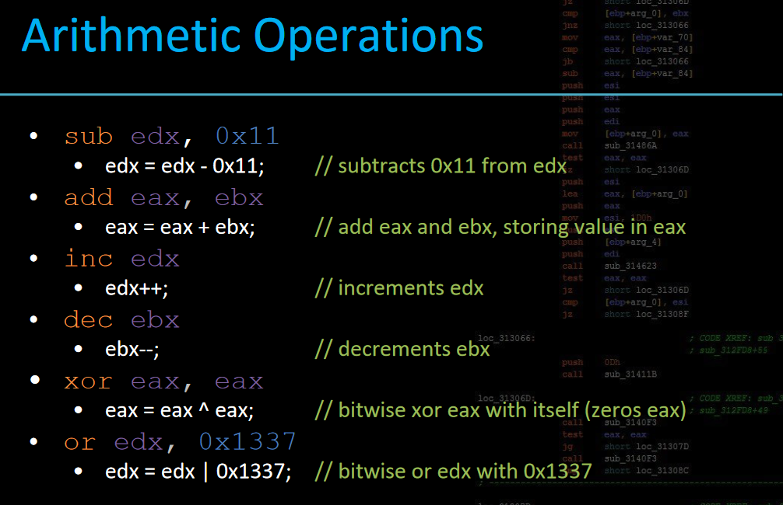

Slide 34
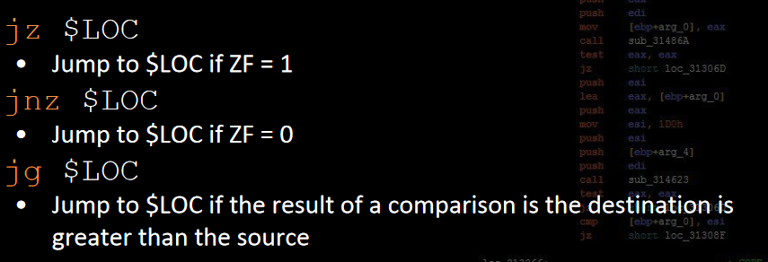
Conditional Jumps and Comparisons
A common instruction that changes the comparison flags for the conditional jumps is - cmp (also test)
cmp operand1, operand2
operand1 - operand2 = >0, ==0 , < 0
test operand1, operand2
operand1 & operand2 = >0 ==0
If the cmp operation yields 0
If the cmp operation yields something other than 0
If the value is greater than 0

Slide 35
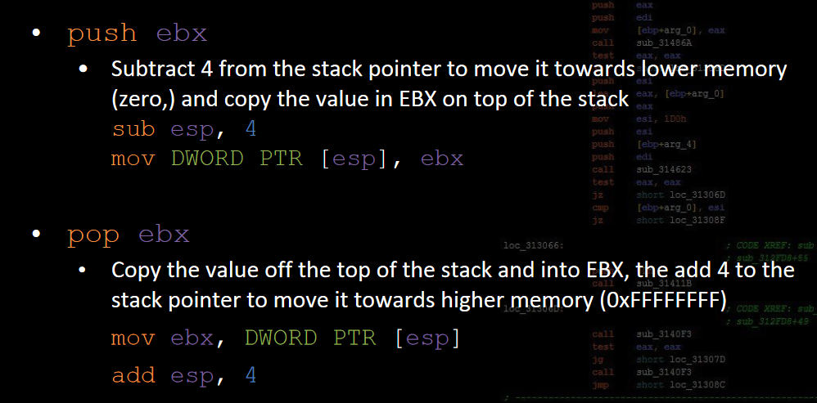
Let’s set aside stack manipulation for now, here are the instructions that manipulate the stack pointer - RSP/ESP

Slide 36
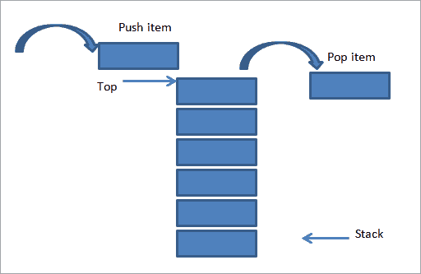
Push and pop simple illustration.

Slide 37
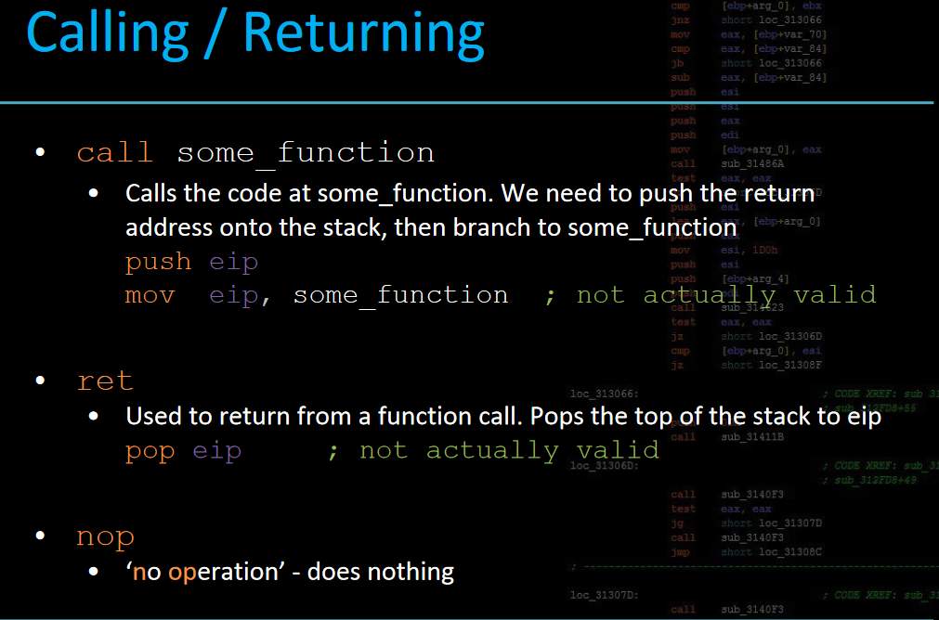
Manipulating the instruction pointer indirectly, function calls and returns.

Slide 38
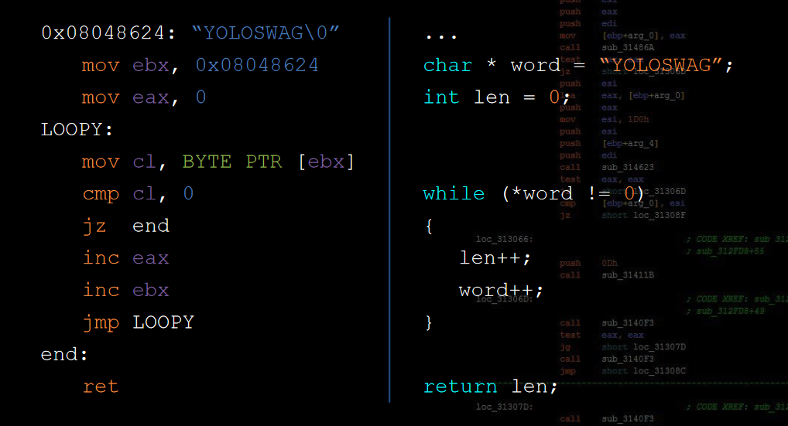

From x86 to C once again!

Slide 39

In class assignment to get to the juicy stuff - reward for whoever completes it first
Homework - yes there’s homework…
WTF
Located in the github repo

Slide 40
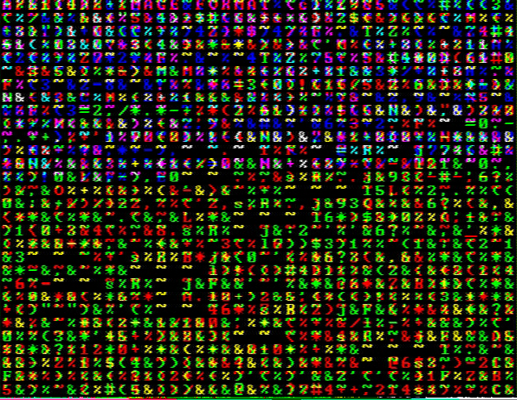
Shellcode
This will be interactive! Be sure to try these commands yourself!

Slide 41
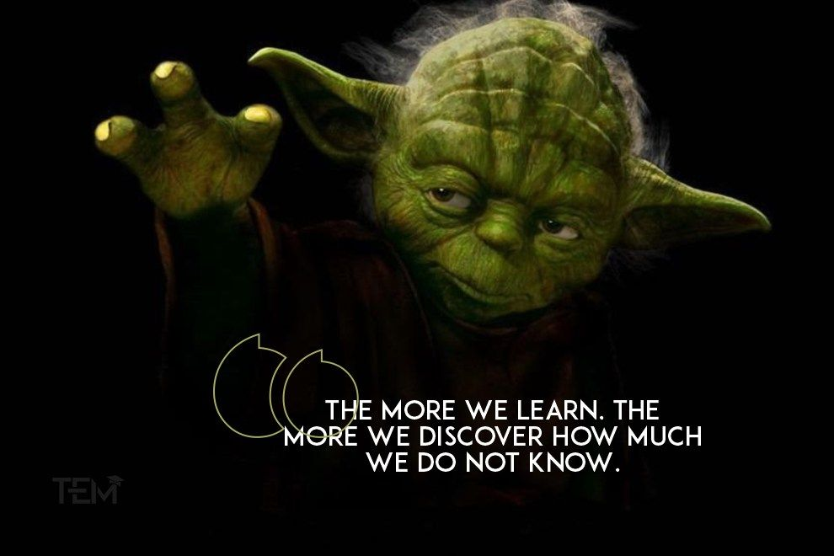
What we need! All together now…
Our command line powers
GDB - (PEDA Extension)
Knowledge of some x86 assembly and system calls
Desir3 to learn!

Slide 42

A look back to the write system call..
We know that “write” is the lowest level function to essentially perform a write. But what if we now look at the assembly code for it ??
Write this out into a file!
vim hello.c ← use any text editor
gcc hello.c -o hello
./hello

Slide 43
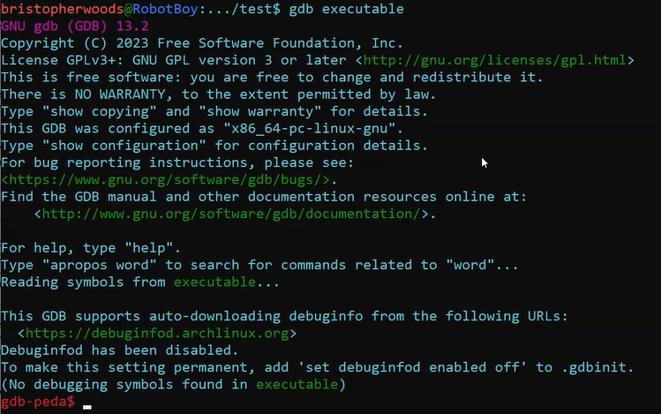

Let’s use GDB to crack this baby open
gdb hello

Slide 44
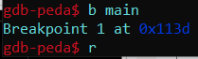
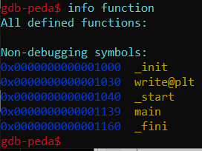
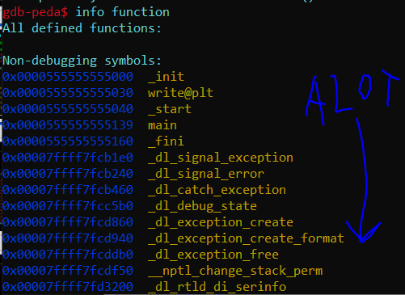
Let’s breakpoint main and run the program!
Doing so loads all the libraries and functions necessary for the program to run during runtime.
Before
After

Slide 45
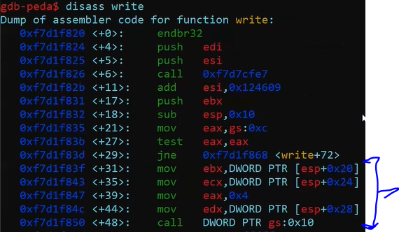
A look into the write system call
NOTE: Yours will be in 64 bit, the addresses will be longer and the instructions within the write def will change a bit
Use the disassemble command to print out all the instructions for the “write” function
! The write system call is actually going to be a wrapper function for the real deal. !
Take a good look at the blue indicated instructions … is there something odd about that call instruction?

Slide 46
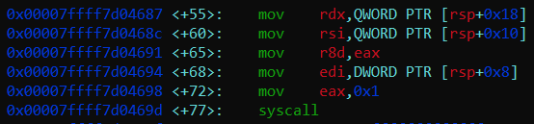
64 bit vs 32 bit - the system call!
32 bit
64 bit

Slide 47
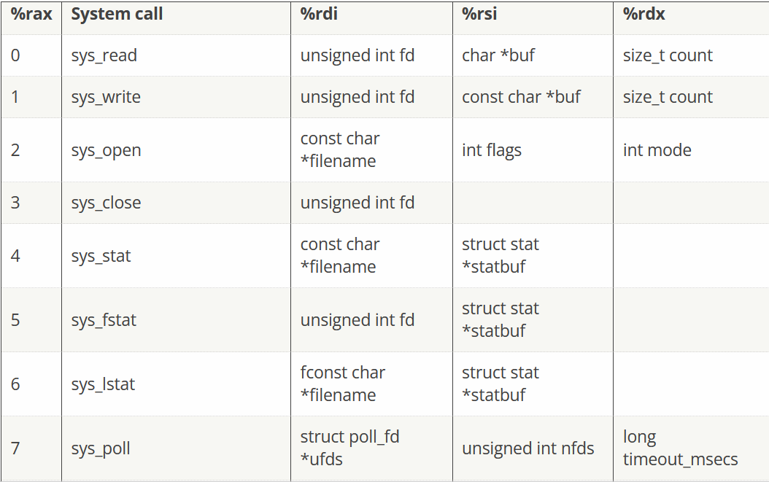
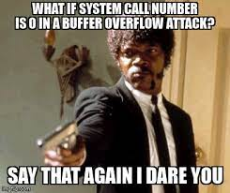
Linux System Call Table - what each register gets loaded with
x86_64 ABI
Linux system call
table

Slide 48
Linux System Call Table - what each register gets loaded with (cont)
| | |
File descriptor Buffer Character count
(stdout) rdi rsi rdx

Slide 49

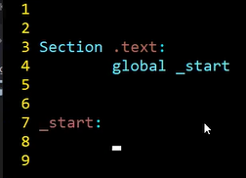
Let’s write assembly to do a syscall manually!!!
Open your favorite text editor…
vim hello.asm
.text represents the start of our executable
global _start should be treated as your main in C

Slide 50
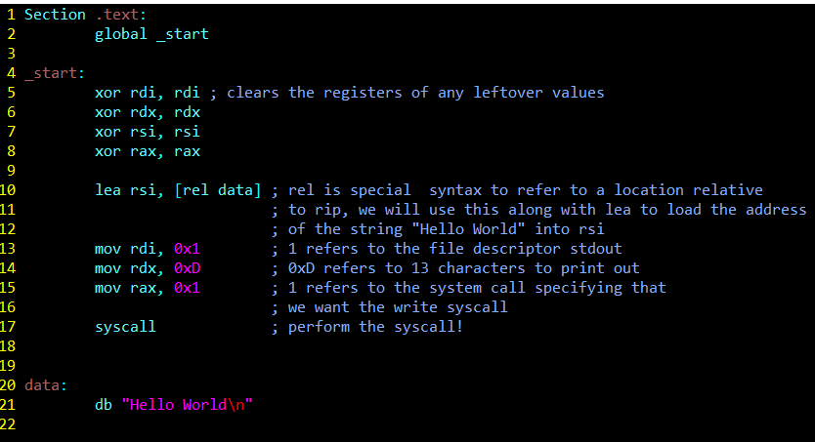
Let’s write assembly to do a syscall manually!!! (cont)
Add a ret instruction here to avoid a crash (trust me bro)

Slide 51
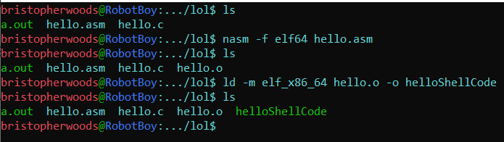
We’ve compiled our shellcode! How on earth are we going to run it?
We’re going to convert our human readable assembly code into bytes and bits of machine code that will be interpreted as those instructions by the CPU.
Follow the commands above to get some nice shellcode.

Slide 52

What are the commands that we are using to do this?
“NASM is an assembler for the x86 and x86-64 architectures. An assembler is a tool that translates assembly language code into machine code or object code that can be executed by a computer's CPU. NASM is used to write low-level code that directly interacts with hardware and system resources. It's commonly used for system-level programming, operating system development, and other tasks where fine-grained control over hardware is necessary.”
For NASM, you can think of it as a compiler, but for “assembly”, converting our human readable text to encoded bytes.
The linker (ld) is a special program that maps our functions and special libraries to our binary - not too important to know for now but necessary to perform.

Slide 53
hello.asm → binary
I will provide a simple bash script to automate this process for you… ./compile.sh <filename>
Check the “practice” folder

Slide 54

LET’S TEST OUR SHELLCODE NOW!!!!
Not yet, there a couple of more steps to perform in order to finally run and test our shellcode!
The binary file only contains instructions for whatever we wrote, but for an executable to launch, we must provide the whole executable format that starts the process…

Slide 55
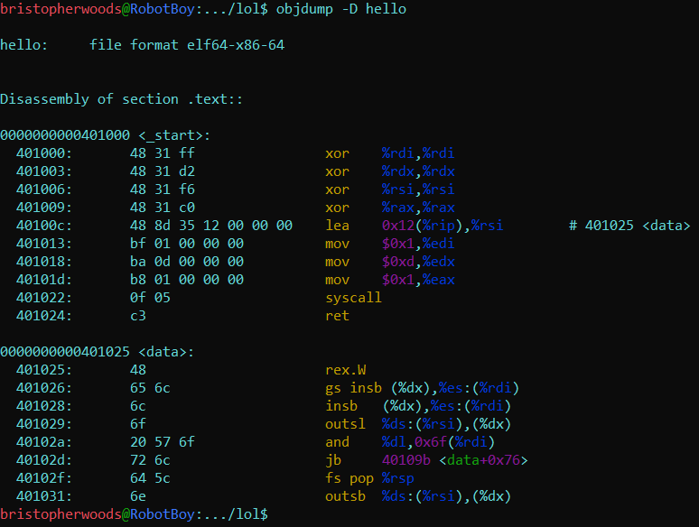
Objdump command - Seeing our assembly code in action!
Objdump is a utility command that lets us see our assembly code and the opcodes that it translate to. You see the bytes right before the instruction? That’s our shellcode, and we want that !!!
This is our string mistakenly interpreted as “instructions” but fear not, everything works as intended

Slide 56

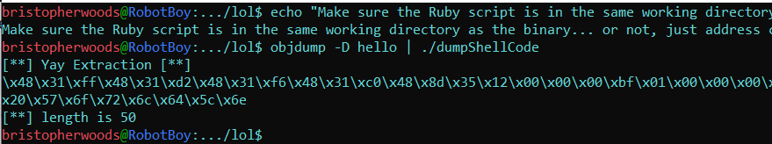
How can we extract tha shellcode?
There really is no standard way of extracting the bytes from objdump.
Handpicking the bytes and assembling it piece by piece is tedious AF. Let’s automate
There is a Ruby script in the solutions folder from the github repo that you downloaded, we’re going to use it in order to extract our bytes nicely

Slide 57
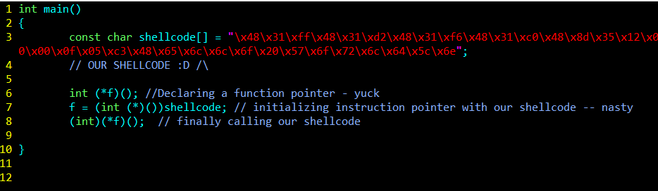
Let’s load our shellcode into another program to run and execute!
This dwells with nasty function pointers. But after this it’ll be over soon !!!
We’ll going to program some voodoo in C to load our shellcode and execute it. Don’t worry if it frightens you, this is a normal reaction :)
Compile with the following flags
gcc testshellcode.c -fno-stack-protector -z execstack -o testshellcode

Slide 58
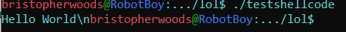

Final Result…..
WOOOOOO

Slide 59

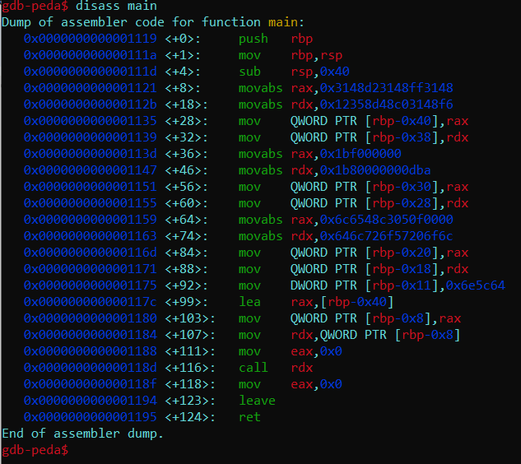
We’ve written some shellcode, finally ..
If we run GDB on our driver program and single step to where our call is done, we can see those very same instructions that we’ve written from earlier!
(Remember, b-breakpoint, n-singlestep, si-step into, r-run)

Slide 60
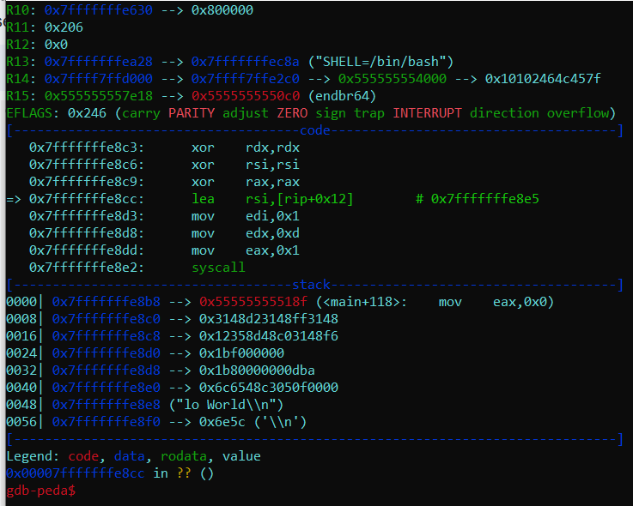

Look Ma! My assembly code :D
After stepping into the
call rdx
Instruction, we start seeing all the assembly code that we wrote from earlier

Slide 61
Final Challenge - Free Pizza slice if you get it..
A good pizza slice ain't cheap, which is why we have an ultimate challenge to test your understanding.. If you solve this challenge, you get a free IOU pizza slice

Slide 62


The End
YOU MADE IT!
See you next time to understand what a BUFFER OVERFLOW is!

